Slide 1
Inclusion and Diversity Management

Slide 2
Table of Content
01 INTRODUCTION
03 REFLECTION
The concepts that learners will learn through the inclusion and the diversity management
Reflection on the topics covered and the knowledge acquired by the learners during the lesson.
02 ACTIVITIES
04 CONCLUSION
Descriptions of the activities included in the lesson to help learners understand the topic and instructions on how to carry them out.
A brief summary of the knowledge, skills and attitudes acquired during the lesson.

Slide 3
01. INTRODUCTION
Inclusion and Diversity Management in the workplace

Slide 4
Learning Outcome
What You Will Learn Today?
This lesson will introduce the topic of inclusion and diversity management in the workplace, how the workplace greatly influences both employee well-being and company earnings. It will illustrate relevant data, problems and possible solutions that European SMEs can implement to improve themselves and their environment.

Slide 5
Lesson Headings
The following topics are covered in this lesson:
Introduction to inclusion in the workplace;
Diversity management

Slide 6
Inclusion in the workplace
Inclusion in the workplace is defined as: “the culture in which the mix of people can come to work, feel comfortable and confident to be themselves and work in a way that suits them and delivers the business needs. Inclusion will ensure that everyone feels valued and importantly, adds value.
Notes:
Inclusive Employers, What is inclusion? Retrieved April 21, 2023 from https://www.inclusiveemployers.co.uk/about/what-is-workplace-inclusion/#:~:text=Inclusion%20is%20the%20culture%20in,valued%20and%20importantly%2C%20adds%20value.

Slide 7
Diversity Management
While inclusion is a process that involves all individuals in a company from the bottom up, diversity on the other hand has to be managed from the top.
There are mainly two types of diversity management:
Intranational diversity management: Refers to a single national context where minority groups of people are included in the workplace through initiatives and support.
Cross-national diversity management: This is more difficult to manage because it comprises citizens and workers from different countries. It is necessary in this case to create a “Diversity Management Plan” in order to achieve and measure objectives.

Slide 8
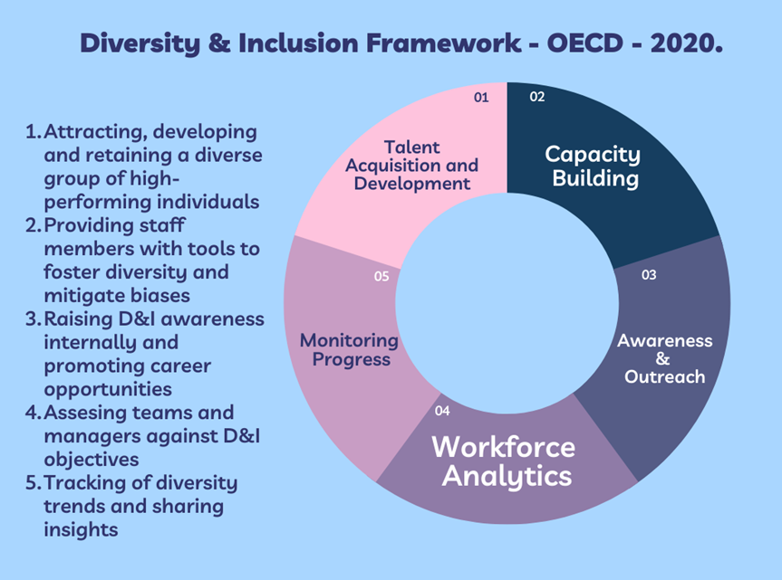
The Diversity and Inclusion Framework
When employees work in an inclusive environment, it makes them happier, more productive and more efficient. Adopting the Diversity and Inclusion Framework can help with this.
Diversity & Inclusion Framework, OECD, 2020

Slide 9
How to promote inclusion and diversity in the workplace
The promotion of inclusion and diversity management in the workplace does not follow standard formulas. However the European Commission has produced 10 basic principles for the application of diversity management in companies.
http://idm-diversity.org/files/EU0708-TrainingManual-en.pdf

Slide 10
02.
ACTIVITIES

Slide 11
Activity 1: Introduction to Inclusion and diversity management
Through this activity we will begin to reflect on our own experiences of inclusion.

Slide 12
Activity 1 Instructions
Step 1
Two participants face each other and the rest of the group form a circle around them.
Step 2
The main group calls out things like place of birth, staple food, hair color, and even religion.
Step 3
The participants in the middle take a step apart when they have a difference. Similarly, when they have something in common, they can take a step towards each other.

Slide 13
Activity 2: Why are you unique?
This activity will mainly serve to raise awareness of diversity within the workplace. Participants will learn new things about each other and understand that their differences can make them stronger as a group.

Slide 14
Activity 2 Instructions
Step 1
Participants gather around in a circle
Step 2
One participant completes the sentence “I am unique because…”
Step 3
Step 2 is repeated with each person in turn.
Step 4
Once everyone has said what makes them unique, the person who started repeats what the person to their left said was unique about them.
Step 5
Group reflection on what they have learnt about each other and how this makes them feel.

Slide 15
Activity 3: Misperceptions
This activity will mainly serve to raise awareness of how easy it is to make assumptions about somebody based on what you think you know about them.

Slide 16
Activity 3 Instructions
Step 1
Working in pairs, think about a time when somebody made an assumption about you that was totally wrong.
Step 2
Explain the assumption to your partner (make sure its something you don’t mind talking about!)
Step 3
Now explain the assumption made about your partner to the rest of the group, explaining why you think the assumption was made.
Step 4
Reflect on your own and the group’s experiences. How easy is it to pre-judge somebody based on what you think you know about them?

Slide 17
Activity 4: Role-play
This activity will help you consider how you might manage a diverse group of people with differing cultural backgrounds in a real life situation.

Slide 18
Role-play Scenarios
Jane from the UK (time zone CET -1)
Sajid from Germany (time zone CET)
Working hours: 9:30 – 17:00
Lunch: 13:00 – 14:00
Commitments: Standing daily 1 hour meeting at 10:00am
Jane is organising this 1 hour pan-European meeting.
Working hours: 8:00 – 18:30
Lunch: 13:00 – 15:00
Commitments: Muslim prayer at 13:11 and 17:34 (approximately 15-20 minutes prayer time required)
Scenario
You have to organise a 1-hour meeting with European colleagues with varying cultural backgrounds and from different time-zones.
Elena from Romania (time zone CET +1)
João from Portugal (time zone CET -1)
Working hours: 8:00 – 16:00
Lunch: 13:30 – 14:30
Working hours: 10:00 – 16:30
Lunch: 14:00 – 15:00
Commitments: Needs to leave at 16:30 sharp to pick up his kids

Slide 19
Activity 4 Instructions
Step 1
In groups of 4, each person takes on the identity of one of the people outlined (Jane, Elena, Sajid and João)
Step 2
Discuss what time to schedule your meeting for. You should consider your own priorities and try to use elements of your persona’s culture to back-up your case
Step 3
Jane has the ultimate decision on which time to schedule the meeting for and should report the decision and reasoning back to the whole class.
Step 4
Reflect on how cultural diversity impacts on working groups and how we can ensure that organisational culture remains inclusive of all different backgrounds.

Slide 20
03.
REFLECTION

Slide 21
What Did We Learn?
What is your most important insight from this workshop?
How will you apply what you have learned in your workplace?

Slide 22
04.
CONCLUSION

Slide 23
What do we now know?
Having explored inclusion and diversity management in an introductory way, we better understand how they influence our actions.
We have noted that inclusivity in any area of life and specifically in work are critical to being able to live in a safe and welcoming environment. Now you have the tools and insights to be able to increase inclusion in your workplace.

Slide 24
THANK YOU

Slide 25
Funded by the European Union. Views and opinions expressed are however those of the author(s) only and do not necessarily reflect those of the European Union or the European Education and Culture Executive Agency (EACEA). Neither the European Union nor EACEA can be held responsible for them. Project Number: 2022-1-BG01-KA220-VET-000089293

